Slide 1
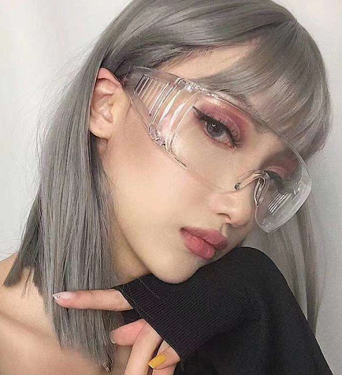
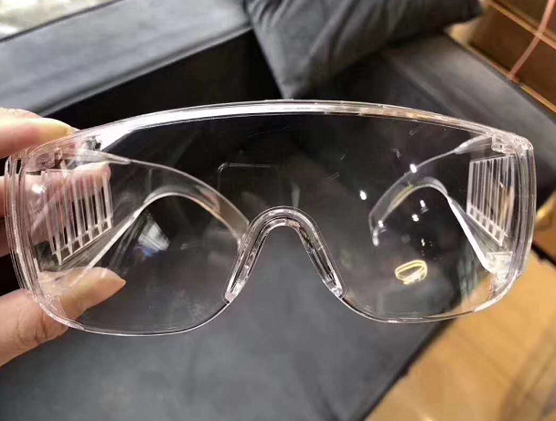
Details
P A C K G I N G
Thickness:2mm
Material:PC
Type:Antifog
Company Confidential

Slide 2
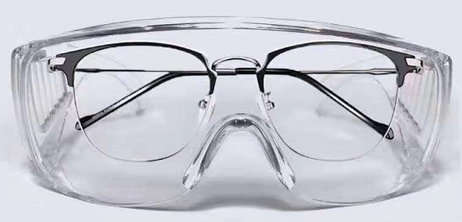
Details
P A C K G I N G
wear with Myopia glasses
Company Confidential

Slide 3
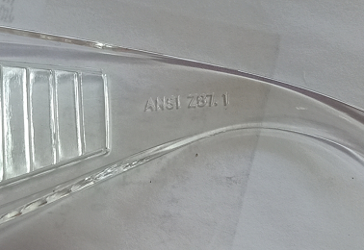
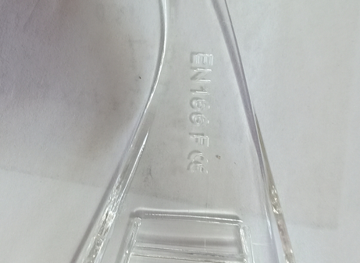
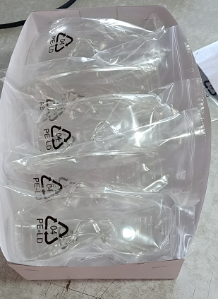
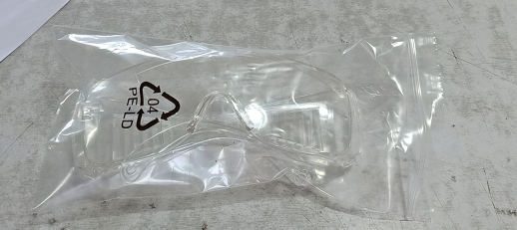
Details
P A C K G I N G
Company Confidential

Slide 4
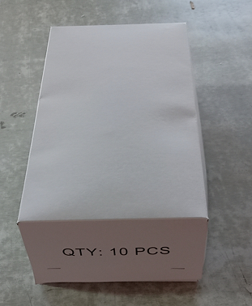
Details
P A C K G I N G
10pcs in one box ,20 boxes in one carton
Company Confidential

